Slide 1

Making New Function by Fixing Some Arguments - from functools import partial

Slide 2
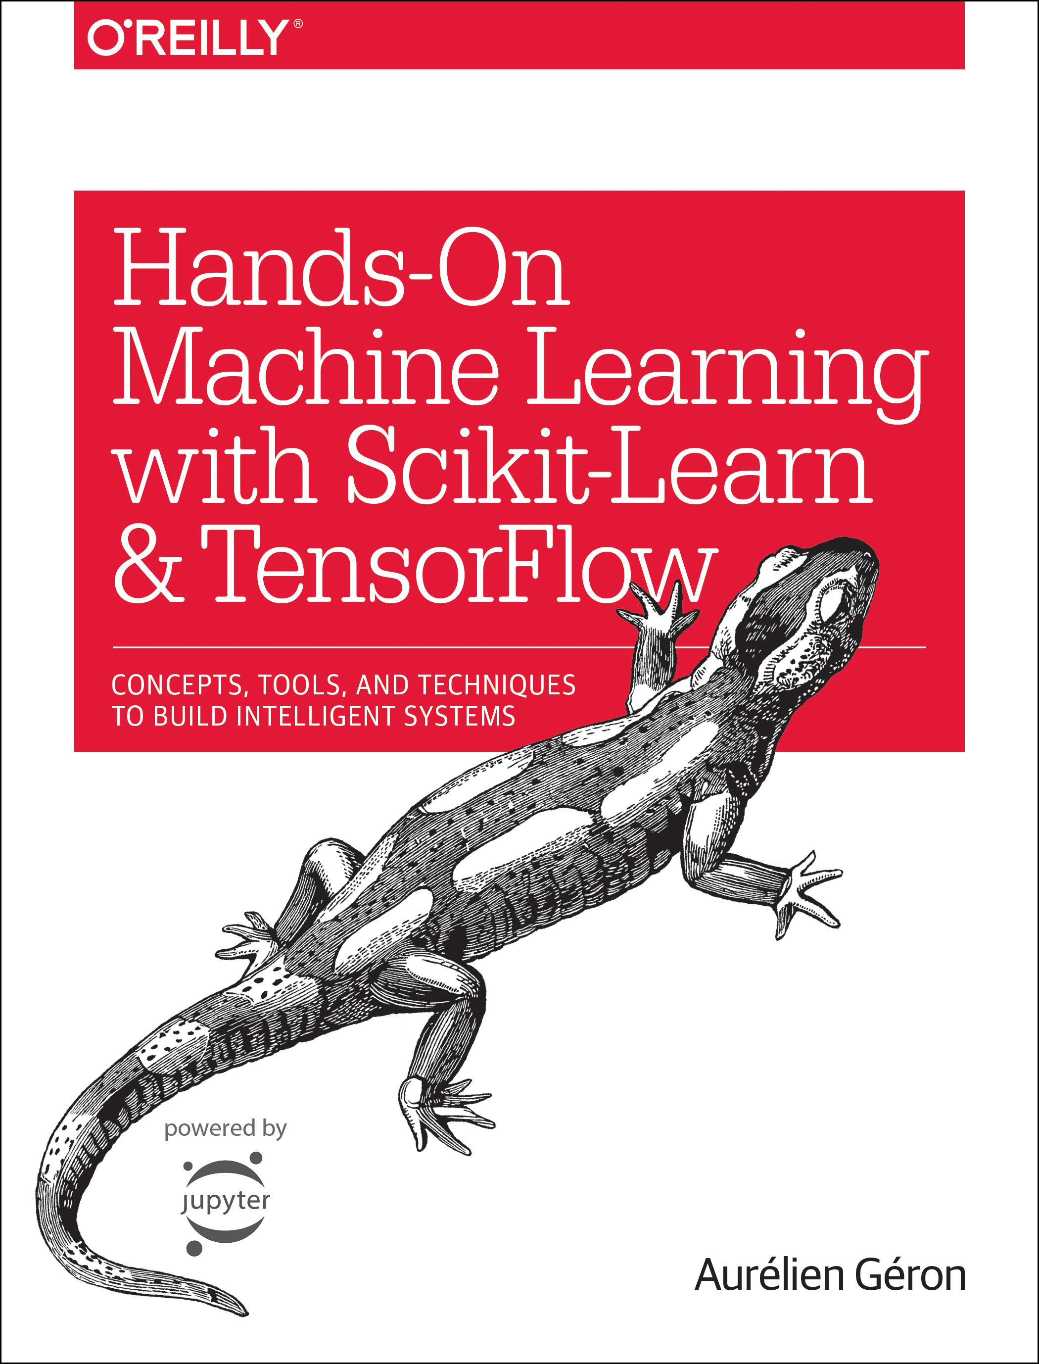
Reference
Chapter 15 (O'Reilly)
Youtube
Code

Slide 3

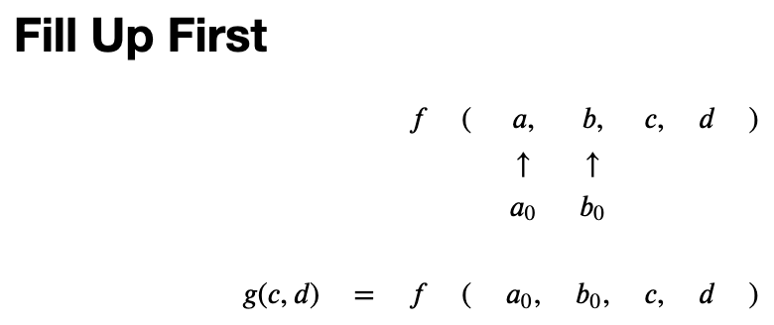

Slide 7
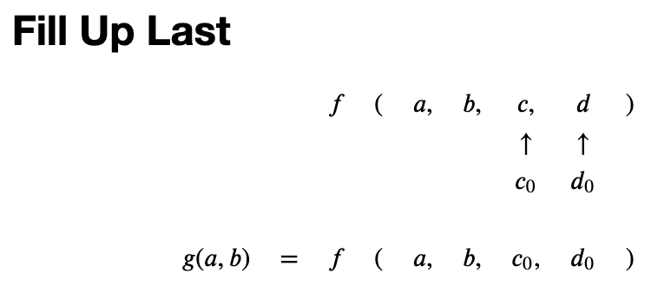

Slide 11
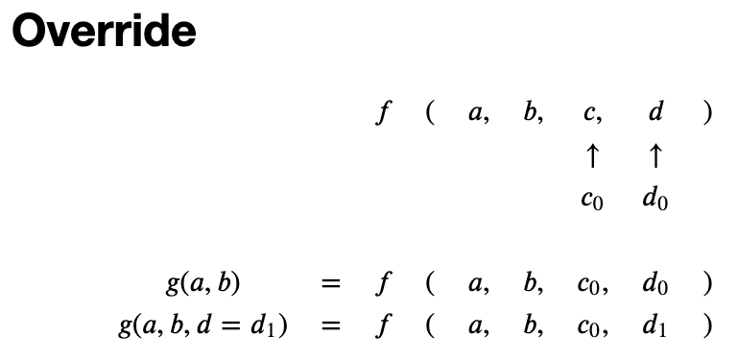

Slide 16
Fill Up First

Slide 17
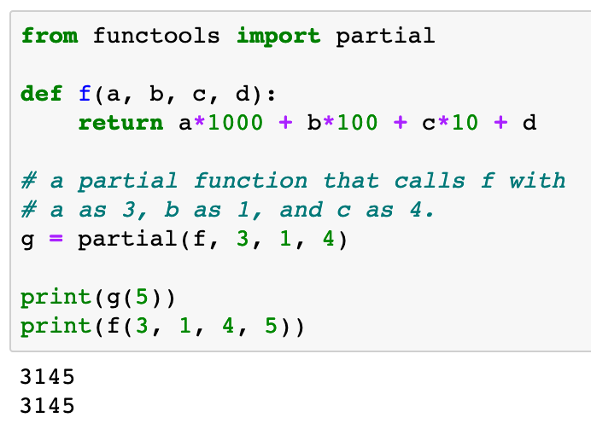

Slide 18
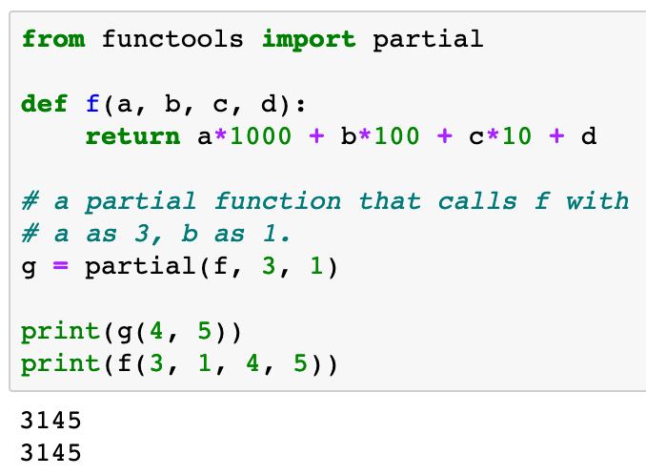

Slide 19
Fill Up Last

Slide 20
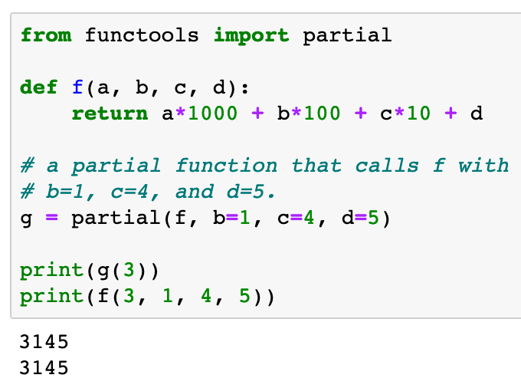

Slide 21
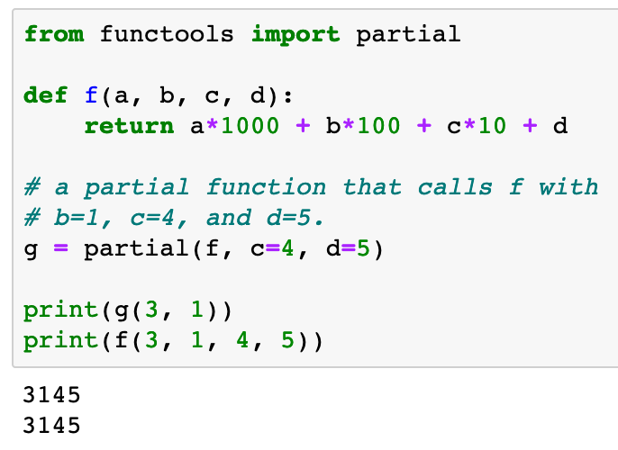

Slide 22
Override

Slide 23
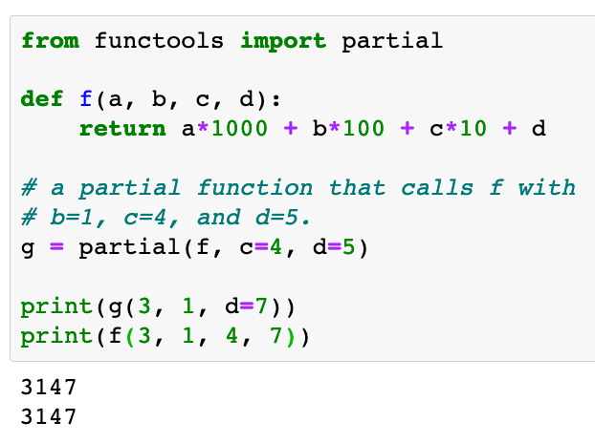

Slide 24
Example from Autoencoder

Slide 25
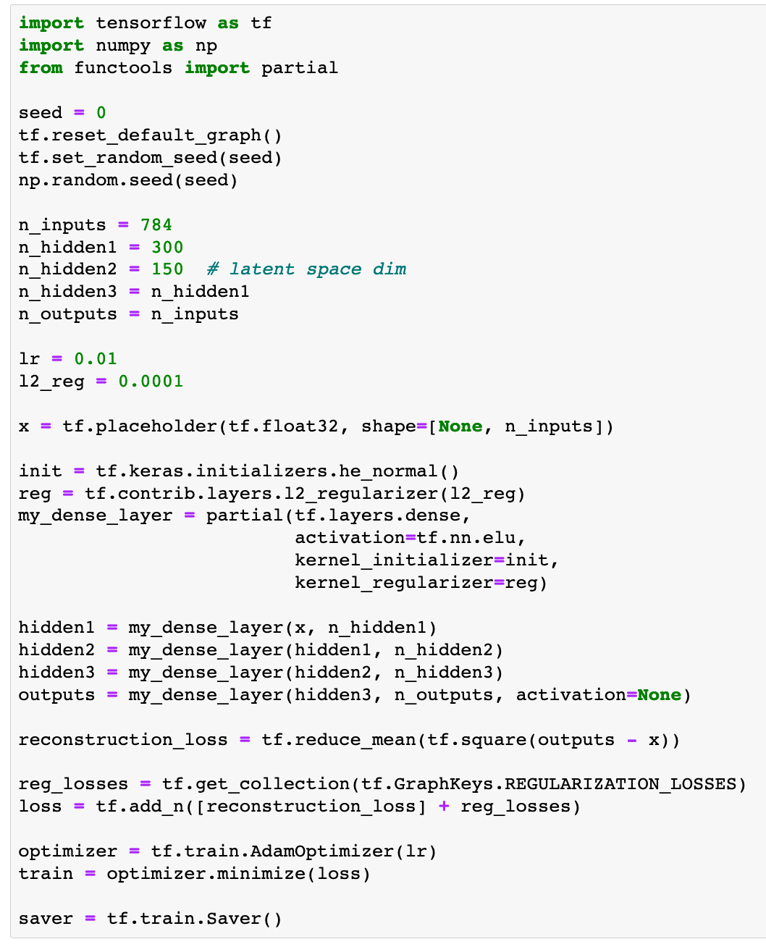

Slide 26
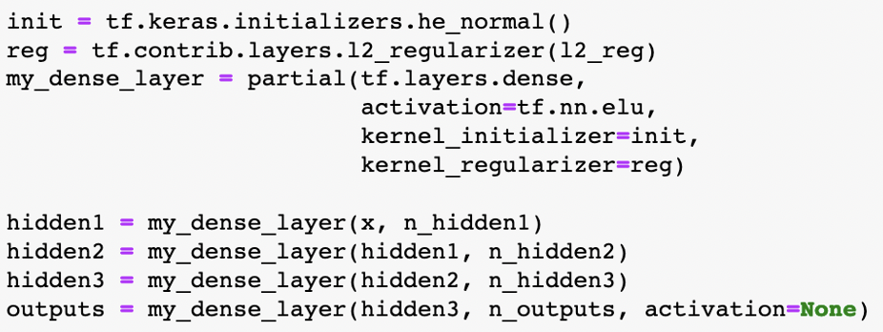

Slide 27
Now
Let’s Play with Code

